Slide 1
Project Plan Presentation Switch Alignment Mobile Game
Team Union Pacific
Jiayue Chai
Zack Joyce
Alexa Kelley
Kyle Martin
Mike Walton
Dan Wylie
Department of Computer Science and Engineering
Michigan State University
Spring 2023

Slide 2
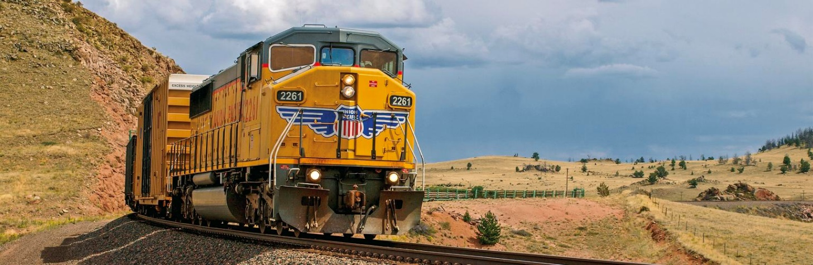
Project Sponsor Overview
Founded under the Pacific Railroad Act of 1862.
Operate over 32,000 miles of railways and 8,300 locomotives.
Building America through efficient, reliable, and sustainable transportation.

Slide 3
Project Functional Specifications
There are a lot of different switches, some of them are hard to identify.
Misidentifying railroad switch alignment often has severe consequences.
Union Pacific operates all over the U.S. so there are many different weather conditions.
Many employees are moved from place to place.
Our mobile game will be captivating and educational.

Slide 4
Project Design Specifications
Train new employees to learn and practice aligning switches.
First person view and realistic game environment.
Random, repeatable conditions.
Immediate feedback will be shown on screen.

Slide 5
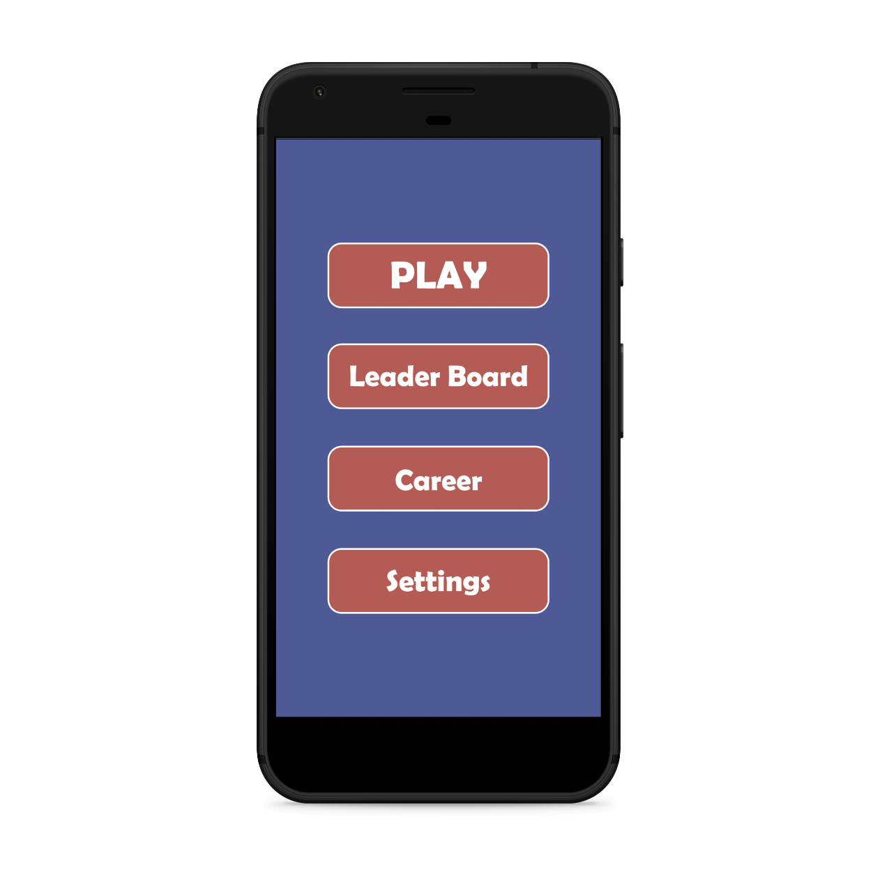
Screen Mockup: Android Application

Slide 6
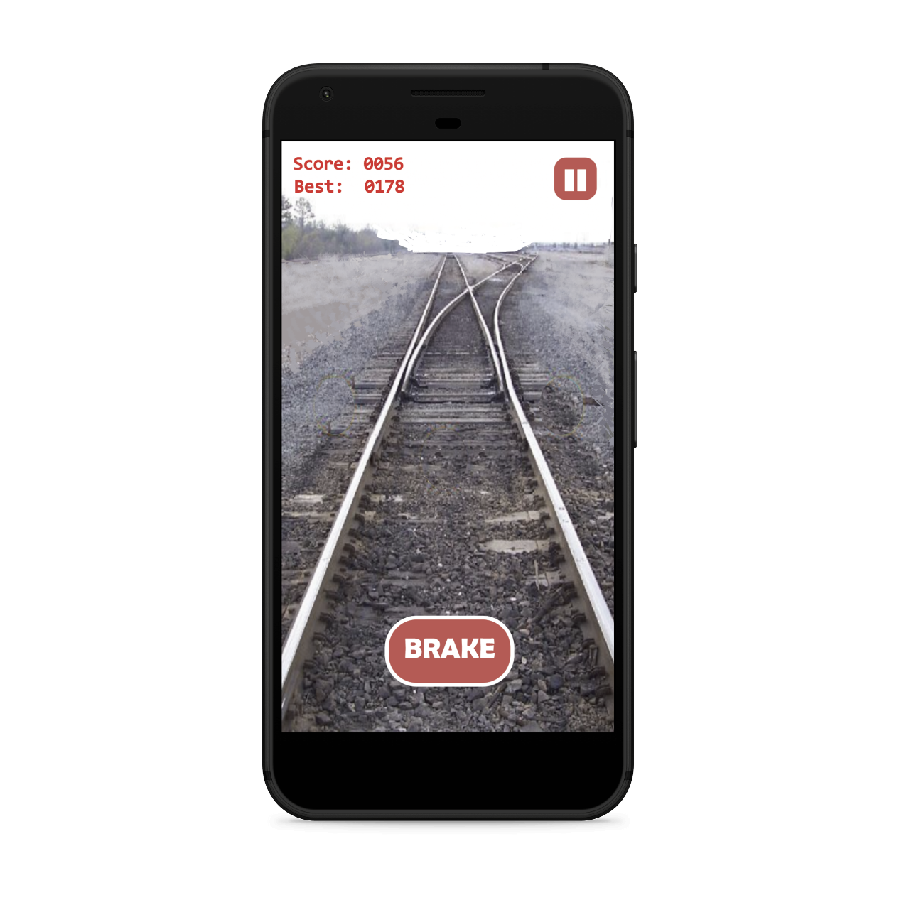
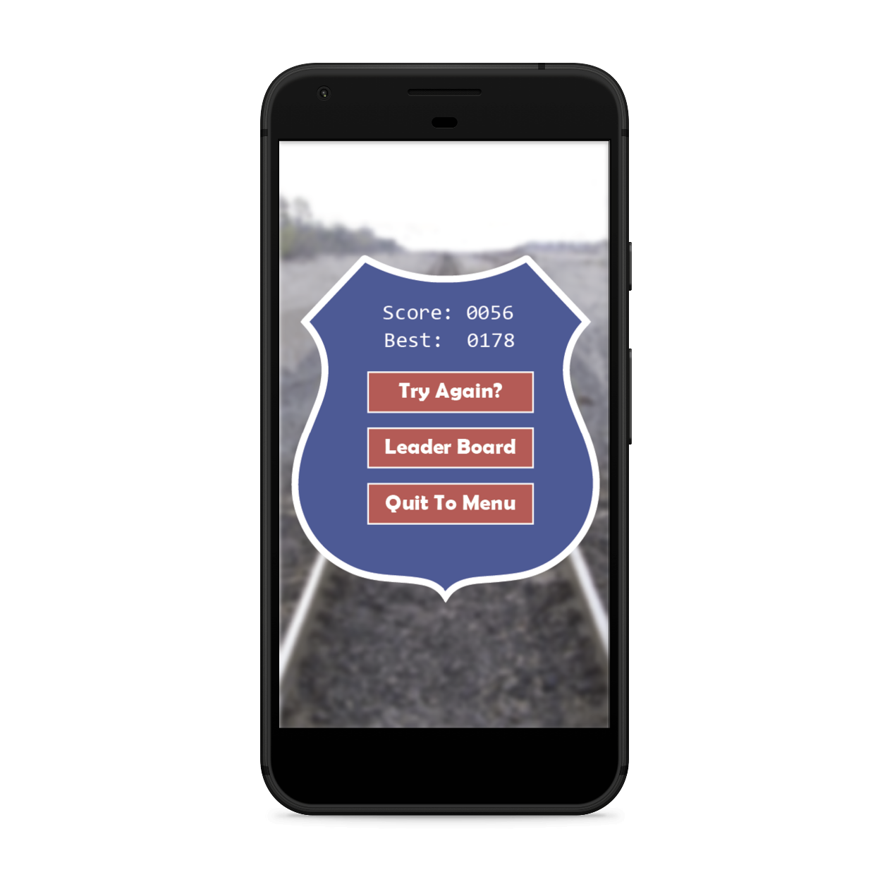
Screen Mockup: Android Application

Slide 7
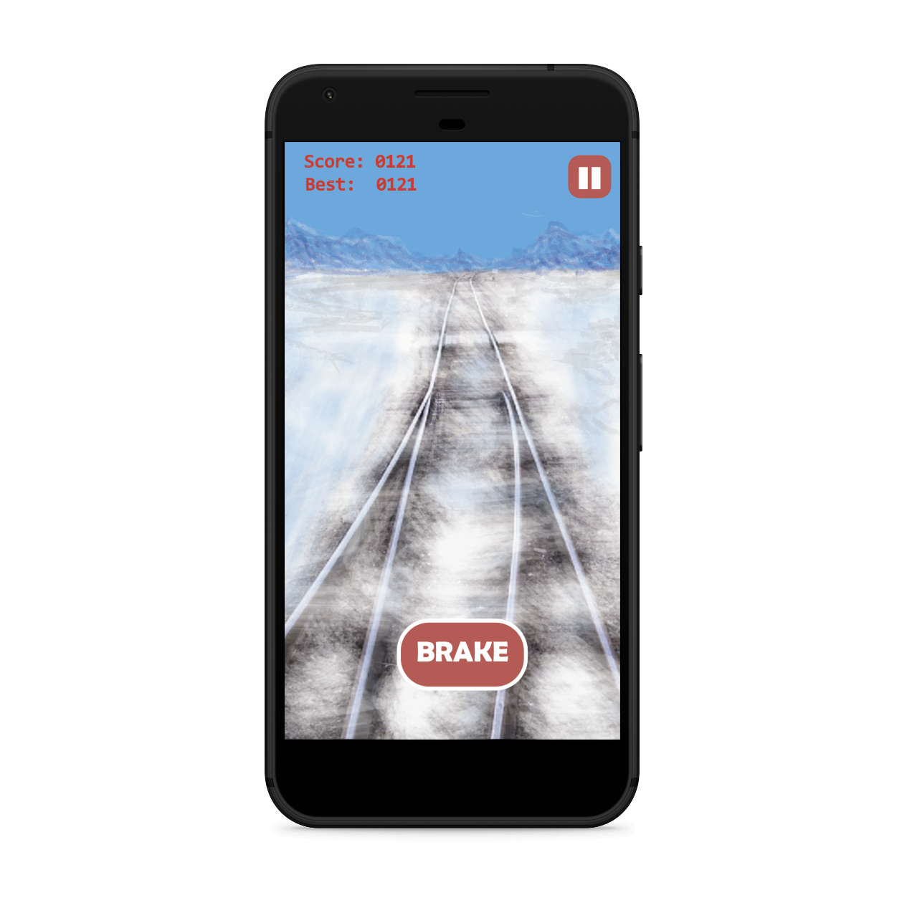
Screen Mockup: Android Application

Slide 8
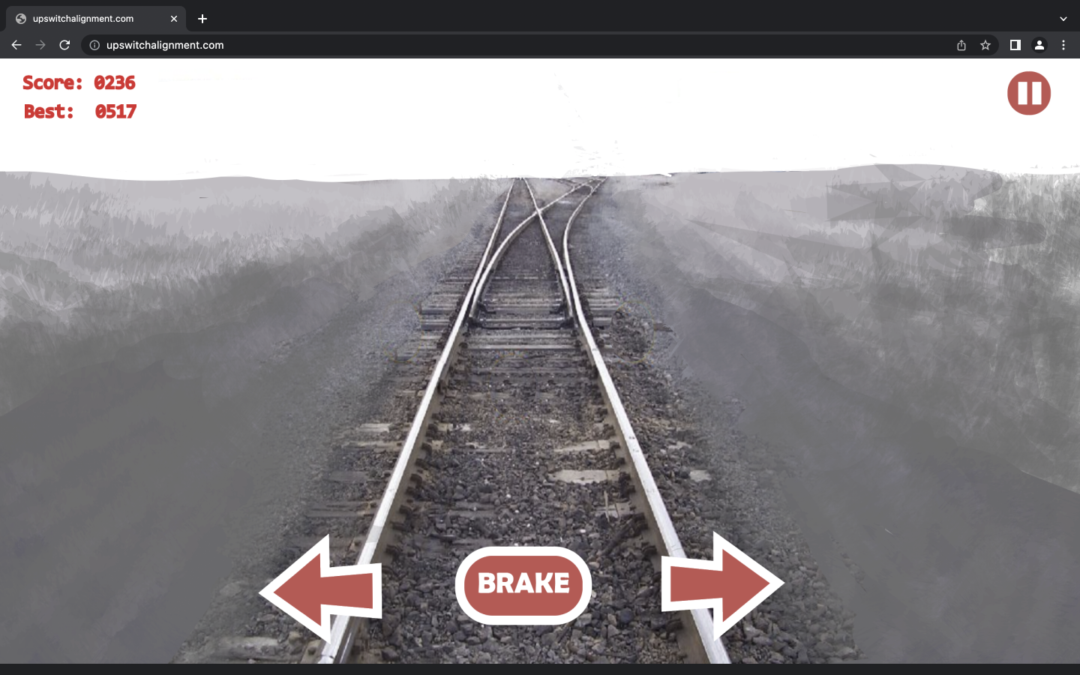
Screen Mockup: Web Interface

Slide 9
Project Technical Specifications
Unity 3D Project - A Unity 3D Project will be used to carry out of frontend aspects of the project.
Oracle Database - A database hosted by Oracle will be used to store all Union Pacific data necessary for the game.
Spring - We will use Spring to create a REST API to allow for communication between the frontend elements in Unity and the backend elements in the Oracle Database.
Zebra Phone – The app has to be functional on the Zebra phone, which is the phone provided to Union Pacific Employees.

Slide 10
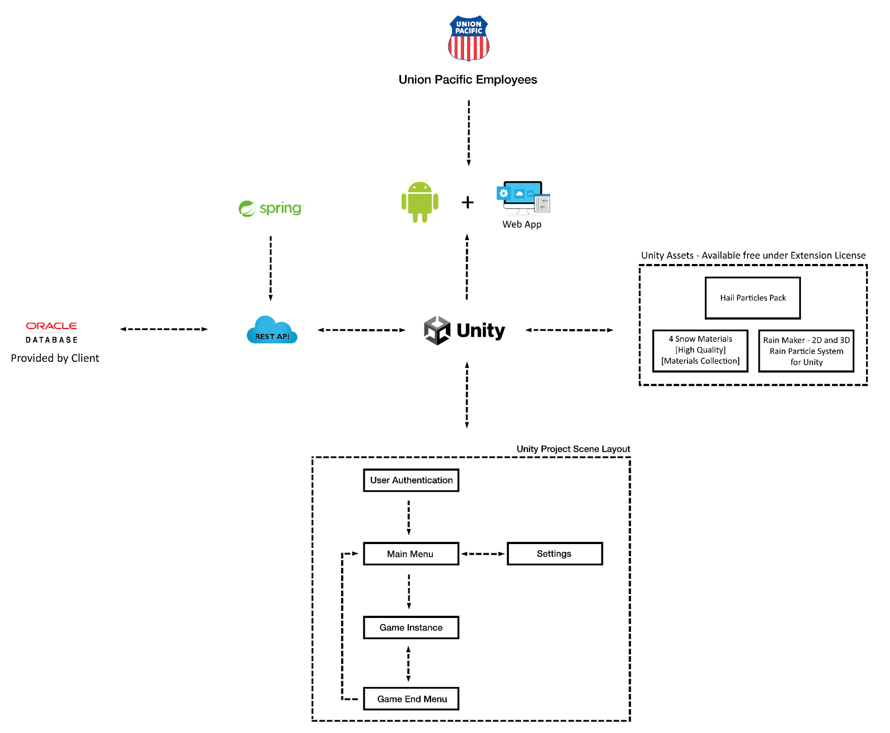
Project System Architecture

Slide 11
Project System Architecture

Slide 12
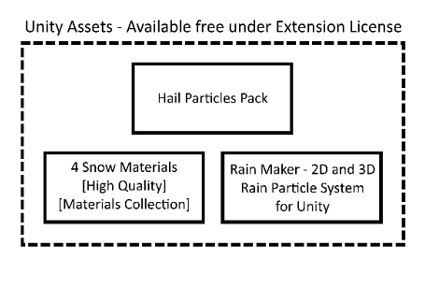
Project System Architecture

Slide 13
Project System Architecture

Slide 14
Project System Components
Hardware Platforms
Zebra Phone: All Union Pacific employees are provided a Zebra phone.
Software Platforms / Technologies
Oracle Database: Oracle Database will be used for all backend purposes of this project.
Spring: Spring will be used to create a REST API to enable communication between our Oracle Database backend and Unity 3D frontend.
Unity: Unity 3D will be used to create the switch alignment simulation.

Slide 15
Project Risks
REST API is compatible with both the client’s preferred database and Unity framework.
A REST API is necessary in order to communicate between the client’s database and the Unity project.
Create a REST API capable of communicating with an SQL database and determine how to utilize it in Unity to call queries.
Incorporating snow in the terrain.
There are no free snow models on the unity store.
Create our own models to show snow on the tracks or acquire models with proper licensing from a free source.
Game performance when running on Zebra phone​​.
Team Union Pacific does not have a Zebra phone; and clients can not provide one in a short time.
We will use Unity device simulator and test the game on our own Androids.
Scalability of database and queries based on employees active​​.
If the scale of database is too large, the project will cost more.
Team Union Pacific will talk to clients and make sure the cost is not out of their price range.

Slide 16
Questions?
?
?
?
?
?
?
?
?
?

